Slide 1
Forensic Sketch-to-Face Transformation

Slide 2

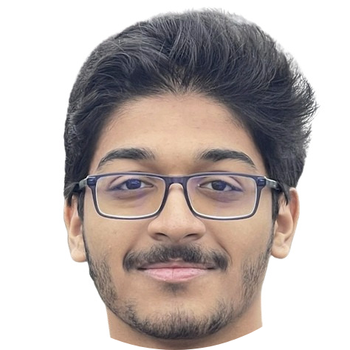

Team Members
 | Name | SRN | Photo
1 | Tharun N Nanju | PES1UG23CS654
2 | Swastik Mohapatra | PES1UG23CS622
CIE Industry Mentor: Prasanna Chandran
PESU Student Mentor: Aditya Sharma
2

Slide 3
Introduction
Explored ProjectPro.io for project ideas
Found GANs suitable for our objectives
Designed for beginners to understand fundamentals

Slide 4
What are GANs?
Generator: Creates data
Discriminator: Evaluates data
Adversarial Process
Improves Generator's ability to produce realistic data

Slide 5
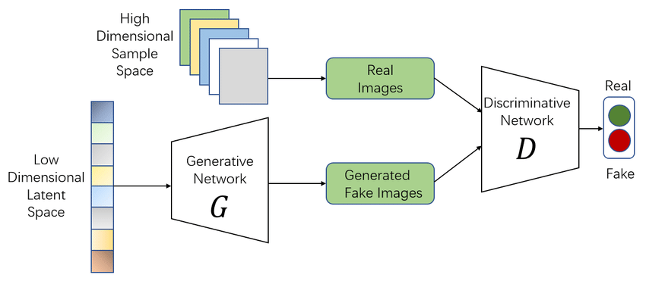
GAN Architecture

Slide 6
Loss Functions
Generator Loss
Discriminator Loss
MinMax Loss

Slide 7
Types of GANs
Vanilla GAN
Conditional GAN
Deep Convolutional GAN
Cycle GAN
Super Resolution GAN

Slide 8
Research and Applications
Unblurring Images
Changing Scenery
Converting Day to Night
Transforming Art Styles

Slide 9
Problem Statement
Utilizing Generative Adversarial Networks (GANs) to transform forensic sketches into photorealistic images addresses the critical need for accurate and efficient suspect identification.
This project aims to revolutionize forensic investigations and significantly enhance law enforcement capabilities.

Slide 10
Methodology
Learn about GANs
1
Implement Basic Code like CIFAR10
2
Begin Sketch to Object Transformation
3
Begin Sketch to Face Transformation
4
Improve Sketch to Face Transformation using novel methods
5

Slide 11
Deliverables
Developed a thorough understanding of GANs and their use in image transformation.
Applied advanced techniques like layer freezing, fine-tuning, and iterative enhancement.
Successfully integrated GPU acceleration for efficient model training.
Demonstrated GANs' potential in transforming sketches into realistic images.

Slide 12
Dependencies
GPU (RTX 3050 Ti mobile)
Tensorflow
PyTorch
CUFS Dataset
Edges2Shoes Dataset
Docker
Matplotlib

Slide 13
Studying GANs
Developed basic models
Faced issues with initial code
Modified basic code from various online sources
Created GIFs for better visualization

Slide 14
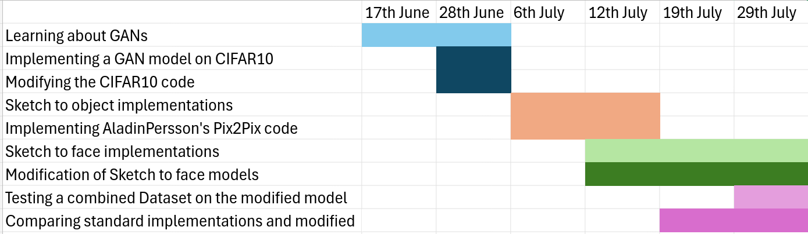
Project Timeline

Slide 15
Starting the Process
Chose SketchyGAN for its comprehensive approach
Encountered significant technical challenges
Sought alternative methods

Slide 16
Sketch to Object Transformation
Adapted Aladdin Persson's code from PyTorch to TensorFlow
Used edges2shoes dataset, but made a critical oversight during testing
Developed a custom test function
Poor quality outputs led to further research

Slide 17
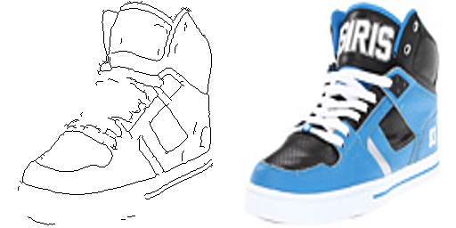
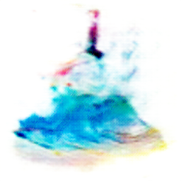

Slide 18
Sketch to Face Transformation
Added a custom testing function to Malikanhar's codebase for streamlined testing.
Experimented with layer freezing, learning rate adjustments, fine-tuning, and early stopping to improve image quality.
Created graphs showing layer-wise losses and accuracies and analyzed activation and weight metrics.
Developed a new approach by superimposing output images onto original sketches and training on composite images.
Initial iteration of the new approach decreased image quality, necessitating further refinement.

Slide 19
Performance Analysis
Plotted layer-wise losses and accuracies
Analyzed activation and weight metrics
Plotted continuous graphs for multiple epochs to study the change per epoch

Slide 20
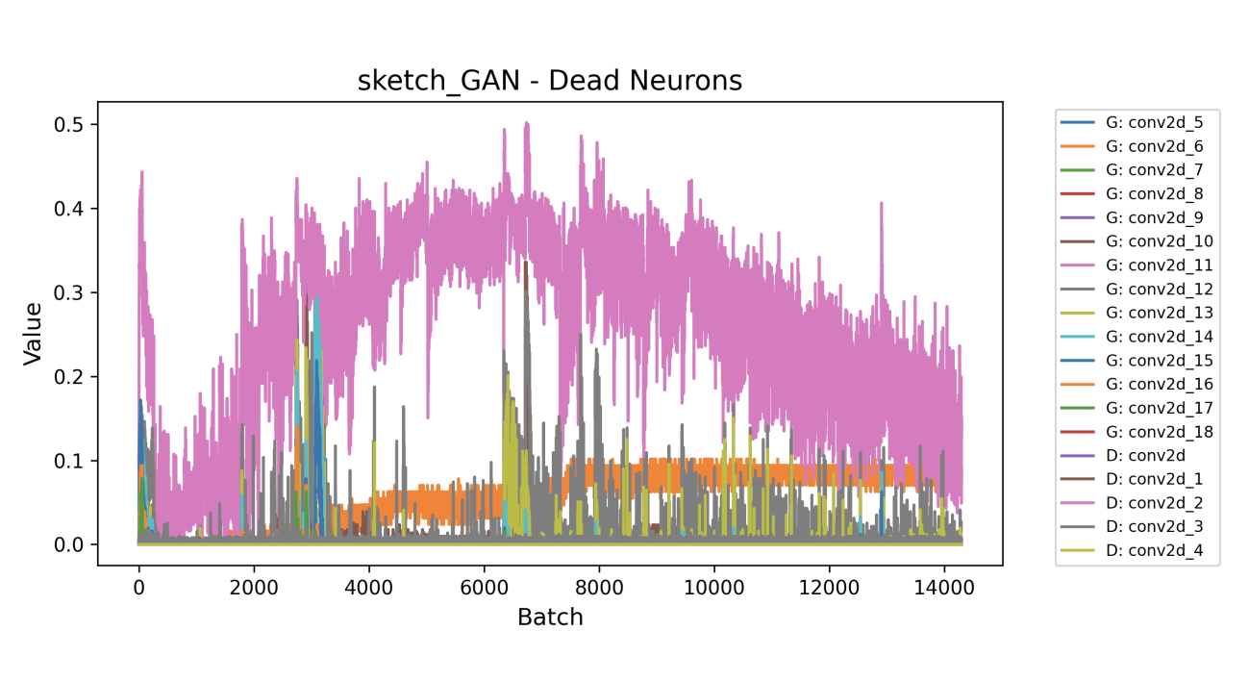
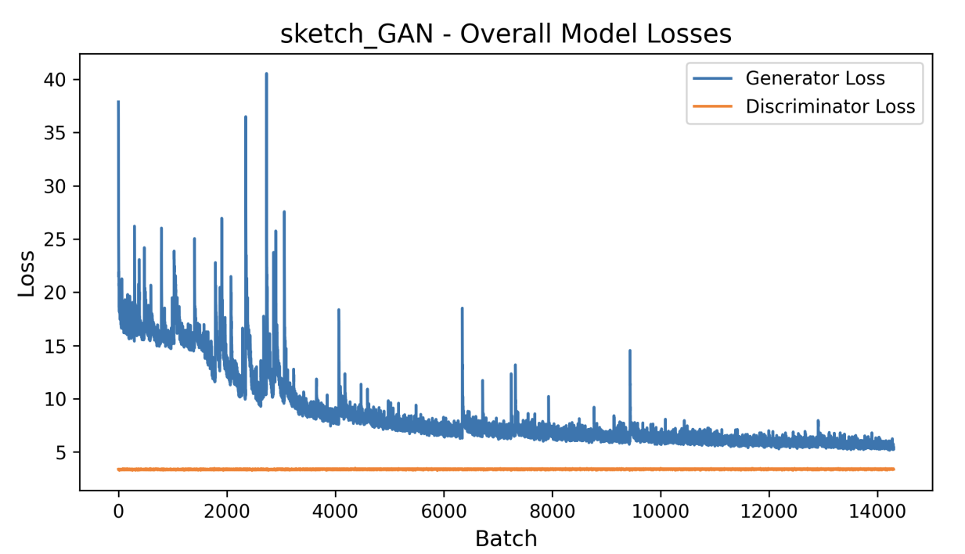

Slide 21
Model Improvements
Custom testing function
Layer freezing
Learning rate adjustment
Fine-tuning and early stopping
Tested different stages of the model to determine when it deteriorates

Slide 22
Twin Model Approach
Superimpose generated images with original sketches
01
Iterative process for quality improvement
02
Initial attempts showed minimal improvements
03
Further refinement needed for better outcomes
04

Slide 24
References
Bhattiprolu, S. (2021, Dec 15). 248 - keras implementation of GAN to generate cifar10 images [Video] YouTube. https://youtu.be/TXy5wZknie8?si=7hnqZk7d_o88n4JK
https://github.com/aladdinpersson/Machine-Learning-Collection/tree/master/ML/Pytorch/GANs/Pix2Pix
https://github.com/Malikanhar/Face-Sketch-to-Image-Generation-using-GAN/tree/master
https://github.com/0sparsh2/Sketch-to-Face-using-Multi-GANs?trk=public_profile_project-button
https://github.com/wchen342/SketchyGAN
Chen, Wengling and Hays, James. (2018, June). SketchyGAN: Towards Diverse and Realistic Sketch to Image Synthesis, The IEEE Conference on Computer Vision and Pattern Recognition (CVPR)
https://www.geeksforgeeks.org/generative-adversarial-network-gan/?ref=lbp
https://machinelearningmastery.com/how-to-develop-a-generative-adversarial-network-for-a-cifar-10-small-object-photographs-from-scratch/
Zhang, Wei and Wang, Xiaogang and Tang, Xiaoou. (2011). Computer Vision and Pattern Recognition (CVPR), 2011 IEEE Conference on, (513--520). Coupled information-theoretic encoding for face photo-sketch recognition.

